Slide 1


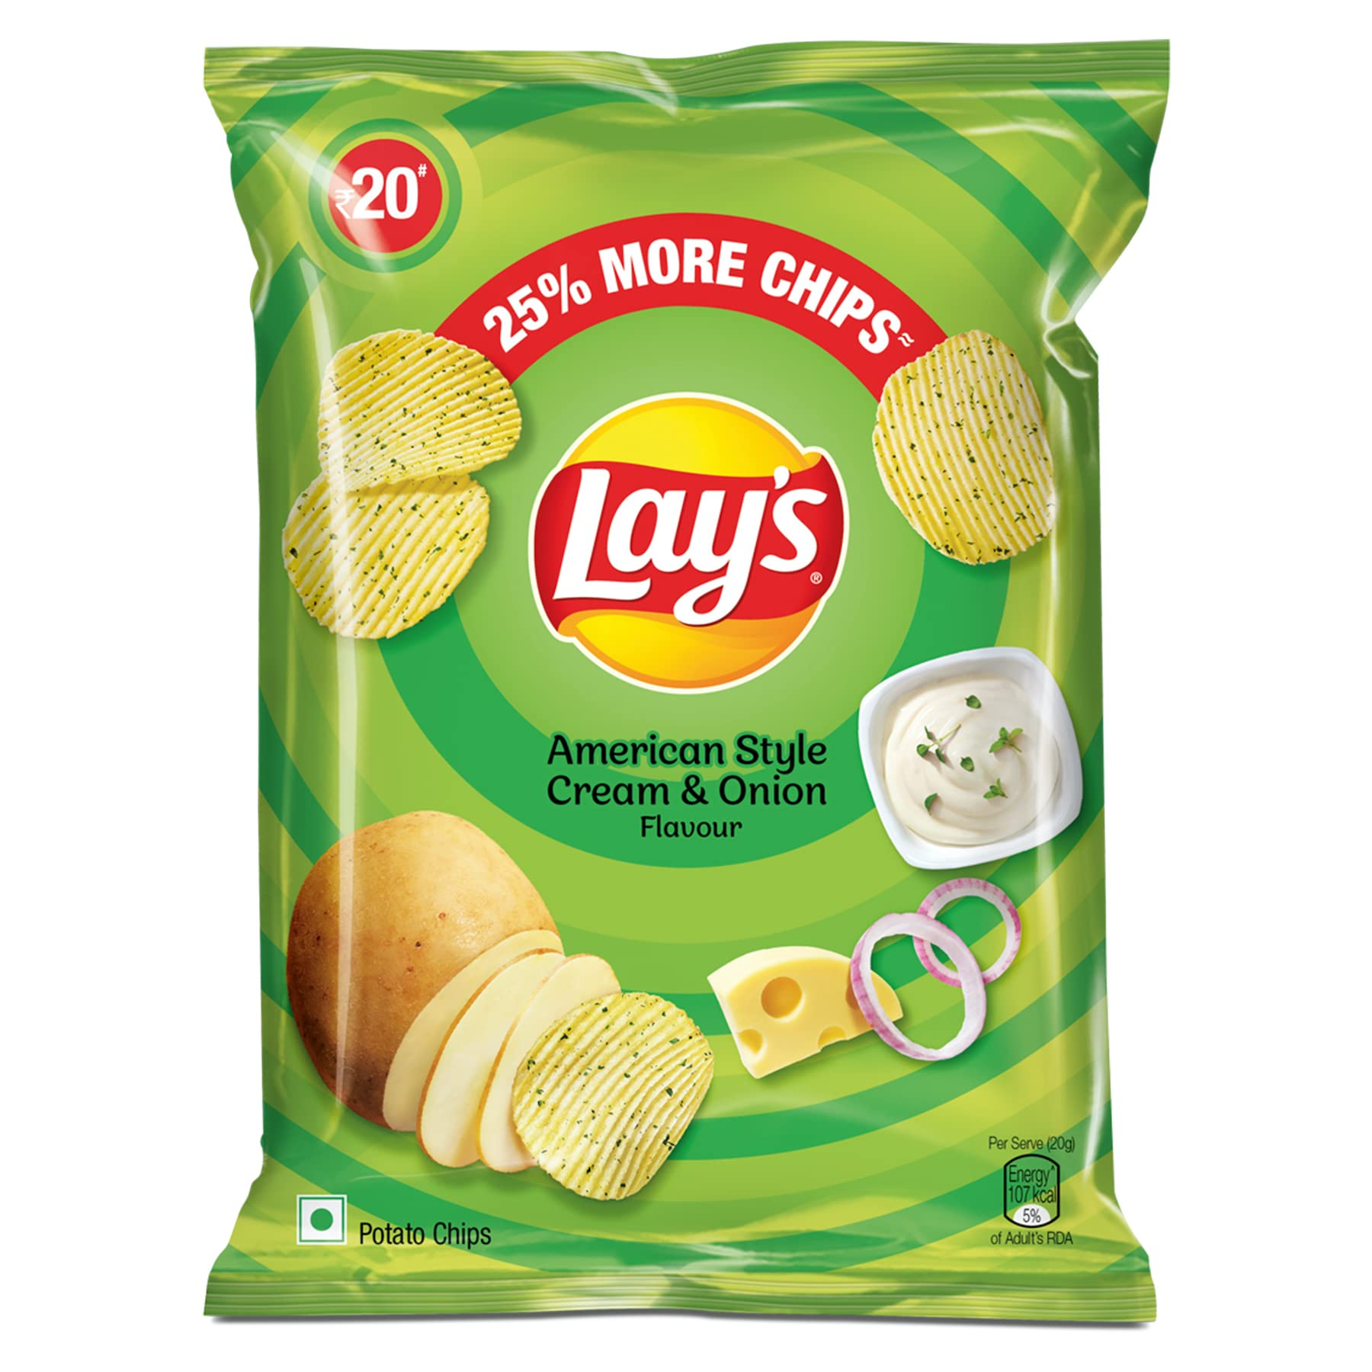
Material Analysis of Lay's American Style Cream & Onion Flavor in India
By
SANKALPA B R -(1RV22CS178)
PRATHEEK RAO M P -(1R22CS147)
NAGAPRASAD NAIK -(RVCE23BCS414)
MANOJ KUMAR B V -(RVCE23BCS409)
Guided by
Dr H.RAJU
Assis. professor

Slide 2
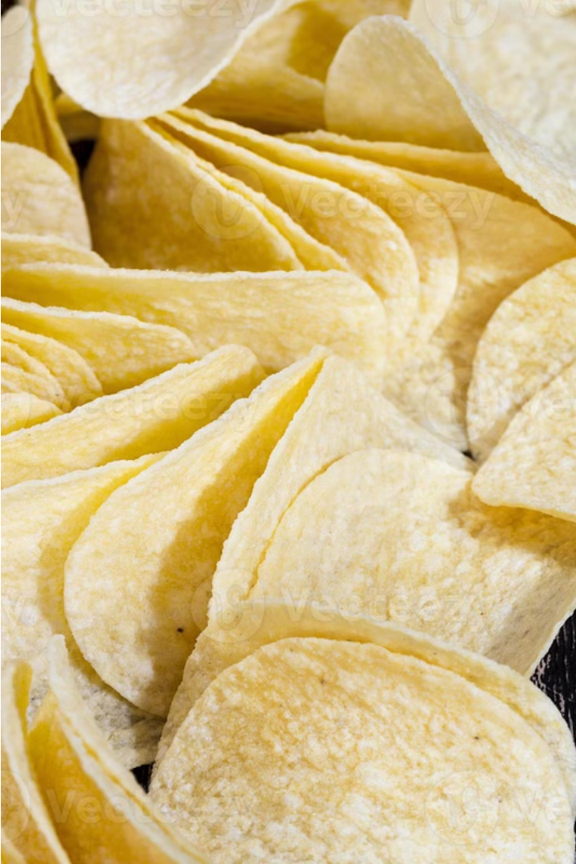
Material Analysis of Lay's American Style Cream & Onion Flavor in India
Lay's American Style Cream & Onion flavor is a beloved classic in the potato chip aisle. This flavor profile combines the savory richness of onions with the creamy indulgence of sour cream, creating a snack that tantalizes the taste buds. The history of this iconic chip flavor dates back to the roots of the Lay's brand and the evolution of American snacking preferences.

Slide 3
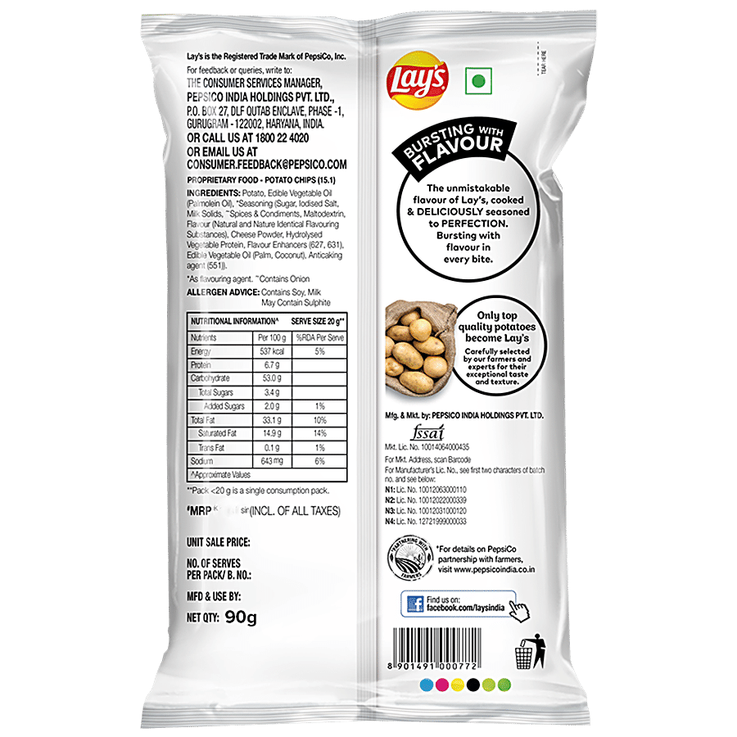
Nutritional Value and Raw Ingredients

Slide 4
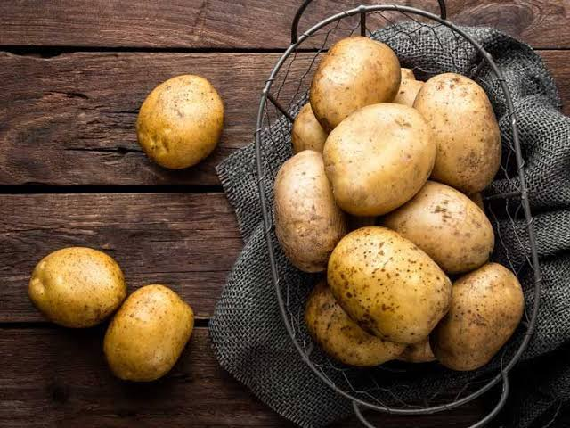
Raw Materials Used
1. Potatoes
Sourcing: Lay's sources high-quality potatoes from a variety of regions. Key suppliers are often local farmers who meet the company's stringent agricultural standards.
Selection Criteria: Potatoes are chosen based on their size, shape, and starch content to ensure consistency in texture and flavor.
2. Vegetable Oils
Types: Common oils used include sunflower, corn, and canola oil.
Sourcing: These oils are obtained from large agricultural suppliers. The choice of oil can vary based on regional availability and health considerations.

Slide 5
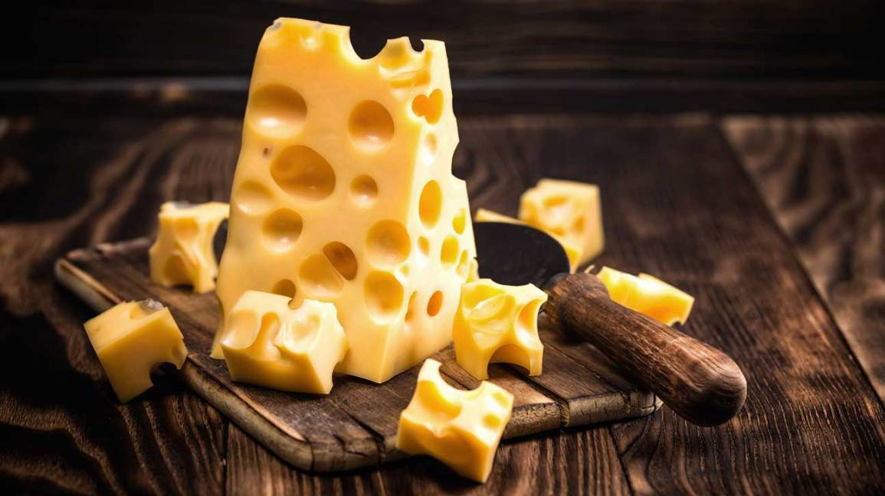
Raw Materials Used
3. Seasonings
Main Ingredients: The American Style Cream & Onion flavor typically includes dried sour cream, onion powder, garlic powder, and various spices.
Sourcing: These seasonings are sourced from specialized suppliers who provide high-quality, food-grade spices and flavorings. Each supplier must adhere to strict safety and quality standards.
4. Other Ingredients
Flavor Enhancers: Ingredients like salt, sugar, and natural flavors are also used.
Sourcing: These are typically procured from established suppliers with a track record of quality and reliability.

Slide 6

Nutritional Facts
1
Calories and Fat
2
Sodium Content
A serving of Lay's potato chips typically contains a significant amount of calories and fat, primarily from the potato and oil used in the frying process.
Lay's potato chips are generally high in sodium. This is due to the salt used in seasoning and the absorption of salt during frying.
3
Carbohydrates and Fiber
4
Vitamins and Minerals
Potato chips are a source of carbohydrates, primarily from the potatoes themselves. They contain a limited amount of dietary fiber.
While Lay's potato chips contain some vitamins and minerals, these are generally low in amounts. They are not a significant source of nutrients.

Slide 7
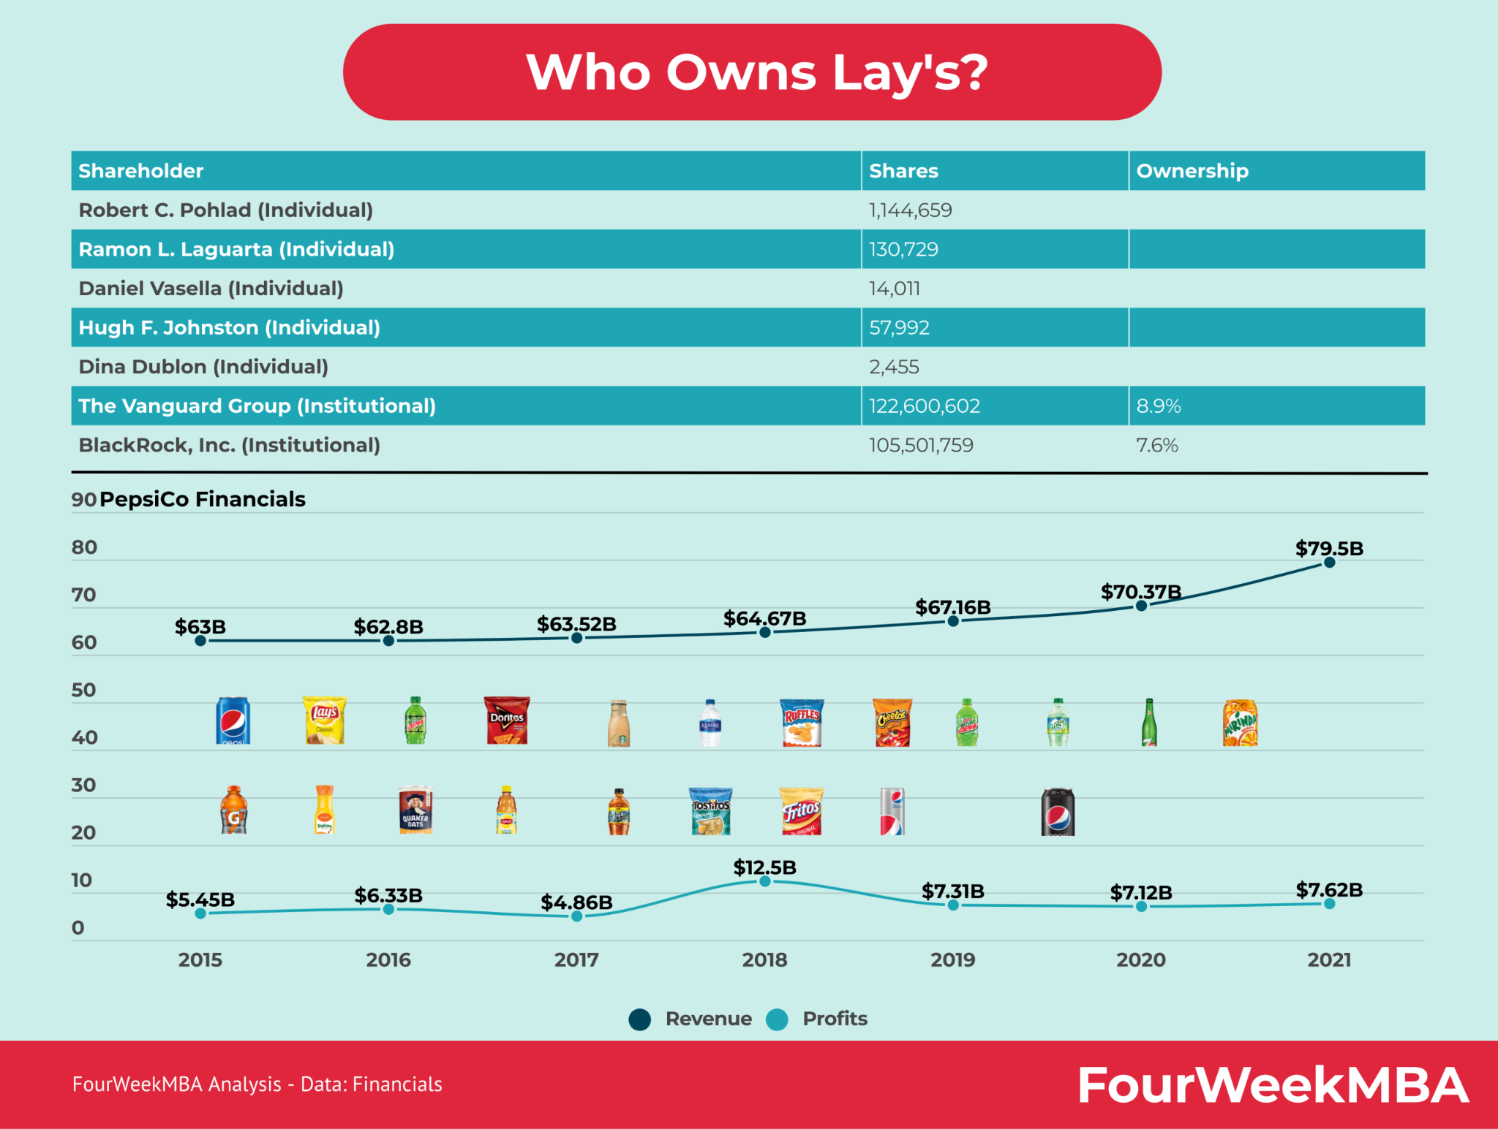

Slide 8
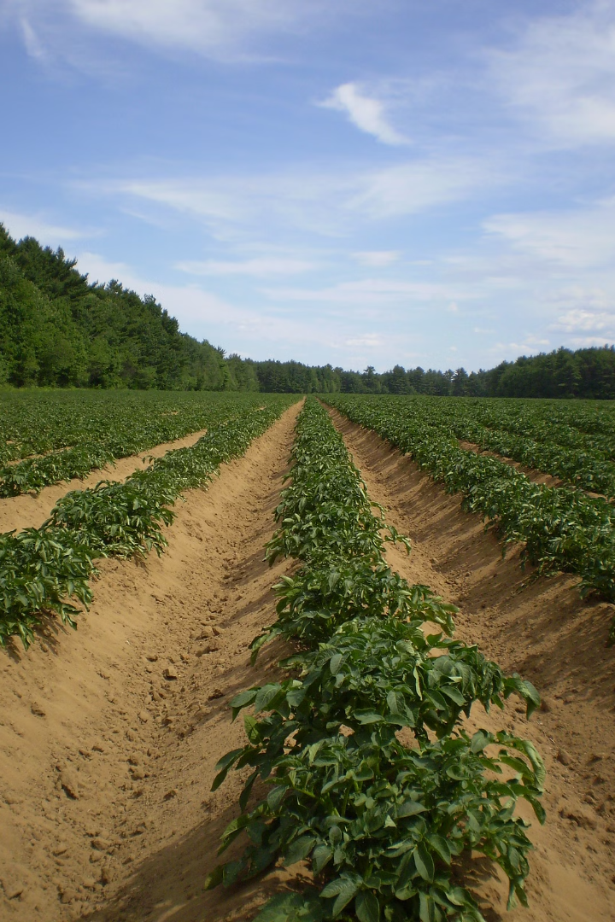

Lays' Operations in India
As a global leader in the snack food industry, Lays has established a significant presence in the Indian market, leveraging the country's rich agricultural resources to source key ingredients for its signature potato chip flavors. From the fertile potato fields of northern India to the thriving onion growing regions of the Deccan plateau, Lays has forged strong partnerships with local farmers to ensure a consistent supply of high-quality raw materials.
Through its well-integrated supply chain and state-of-the-art production facilities, Lays is able to deliver the same beloved taste of its American Style Cream and Onion flavor to consumers across India, while supporting the livelihoods of thousands of agricultural workers and contributing to the country's economic growth.

Slide 9
Potato Sourcing: Locations and Cultivation in India
Potato Cultivation in India
Sustainable Farming Practices
Strict Quality Control
Lays sources its potatoes from various regions across India, where the climate and soil conditions are ideal for growing high-quality potatoes. Key potato-growing hubs include the states of Uttar Pradesh, Punjab, and West Bengal.
The potatoes are meticulously inspected at every stage, from seed selection to harvest, to guarantee they meet Lays' stringent quality standards.
Lays works closely with local farmers to implement sustainable farming techniques, ensuring the long-term health of the land and the communities that depend on it.

Slide 10

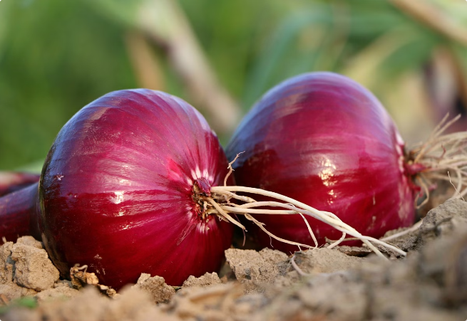
Onion Procurement: Regions and Growing Practices
Onion Growing Regions
Lays sources its onions from the major onion-producing regions in India, including Maharashtra, Gujarat, and Rajasthan.
Sustainable Cultivation
Lays works closely with local farmers to promote sustainable onion cultivation practices, minimizing environmental impact and ensuring a consistent supply of high-quality onions.
Stringent Quality Checks
The onions are carefully inspected and selected to meet Lays' exacting standards for flavor, texture, and freshness.

Slide 11

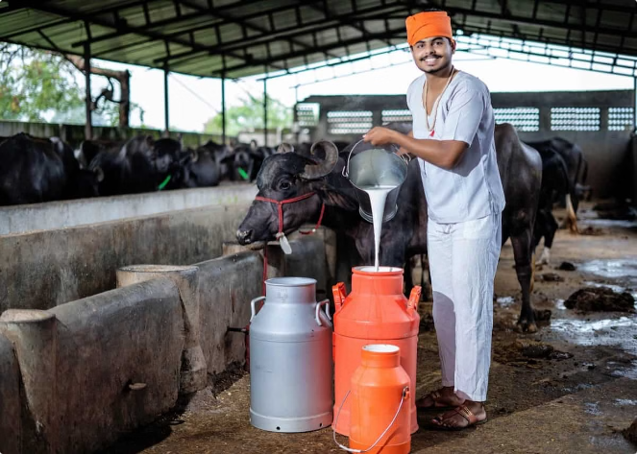
Cream Ingredient Acquisition: Dairy Farms and Production
1
Dairy Farm Partnerships
Lays collaborates with reputable dairy farms across India to source the high-quality cream used in their American Style Cream and Onion flavor.
2
Stringent Quality Standards
The cream is subject to rigorous testing and quality control measures to ensure it meets Lays' strict requirements for flavor, consistency, and purity.
3
Sustainable Production
Lays' dairy partners employ environmentally-friendly practices, such as reducing waste and conserving water, to minimize the impact of their operations.

Slide 12
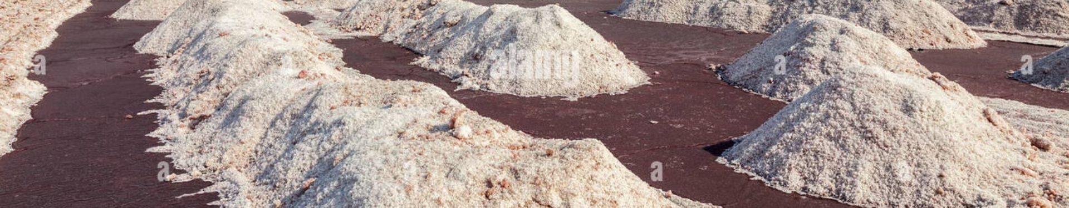



Salt Sourcing: Mines and Harvesting Methods
Salt Mines
Purity Standards
Sustainable Harvesting
Lays sources its salt from the renowned salt mines of Gujarat, where the mineral is harvested using traditional, eco-friendly methods.
The salt undergoes rigorous quality checks to ensure it meets Lays' stringent purity and taste requirements.
Lays works closely with the local salt-producing communities to promote sustainable harvesting practices that preserve the environment.

Slide 13
Palm Oil and Sunflower Oil Extraction in India
Palm Oil Extraction
Sustainable Practices
Sunflower Oil Production
Quality Control
Lays sources its palm oil from the rich, fertile regions of southern India, where the oil palm trees thrive in the tropical climate. The palm fruits are carefully harvested and processed using modern, efficient techniques to extract the high-quality oil.
Both the palm and sunflower oils undergo rigorous testing and quality checks to meet Lays' strict standards for purity, flavor, and performance during the frying process.
Lays works closely with its palm oil suppliers to ensure sustainable cultivation and harvesting methods. This includes protecting local ecosystems, minimizing waste, and supporting the surrounding communities.
For the sunflower oil used in their American Style Cream and Onion flavor, Lays sources from the major sunflower-growing regions of central and northern India. The sunflower seeds are expertly pressed to extract the flavorful, high-quality oil.

Slide 14

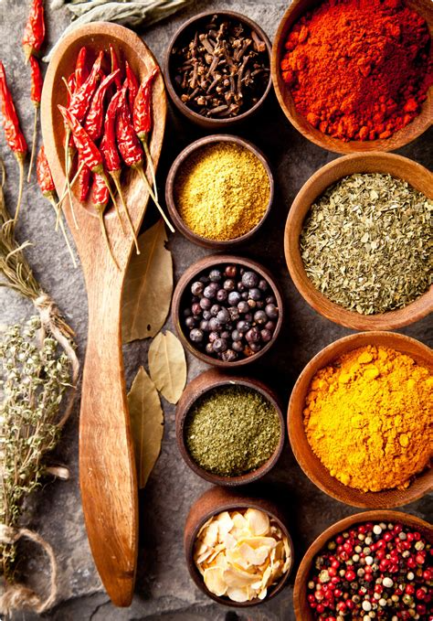



Spice Blends: Curating the Flavor Profile
Spice Selection
Lays carefully selects a blend of premium Indian spices to complement the cream and onion flavors in their American Style chips.
Flavor Balancing
The spices are expertly combined to create a harmonious flavor profile that delights the senses.
Quality Assurance
Rigorous testing ensures the spice blend meets Lays' high standards for taste and consistency.

Slide 15
Growth of Lay’s
Founding and Early Growth (1930s)
Herman Lay founded Lay's in 1932, initially selling potato chips from his car in Nashville, Tennessee.
By 1938, he acquired a potato chip manufacturing company, forming H.W. Lay & Company.
Expansion and Branding (1940s)
Lay's gained popularity and became the first snack food manufacturer to advertise on television in 1944, significantly boosting its brand recognition.
Merger and Formation of Frito-Lay (1960s)
In 1961, H.W. Lay & Company merged with The Frito Company to form Frito-Lay, Inc.
Frito-Lay merged with Pepsi-Cola in 1965 to create PepsiCo, Inc., enhancing Lay's expansion capabilities.
Global Expansion and Product Innovation (1980s-2000s)
Lay's expanded internationally, introducing flavors tailored to regional preferences.
Introduced Baked Lay's in 1995 to cater to health-conscious consumers and continued to innovate with new flavors and product lines.
Lay's in India
Lay's entered the Indian market in the early 1990s, becoming a popular snack brand.
Offers flavors catering to Indian tastes, with American Style Cream & Onion being a popular choice.

Slide 16
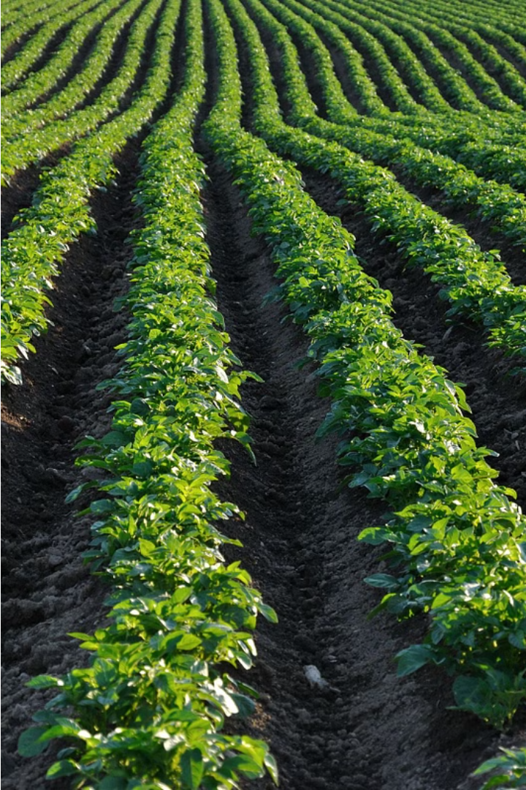
Process of Lay's Potato Chips
Lay's potato chips are a beloved snack food made from high-quality potatoes, carefully selected and prepared to deliver a crisp, flavorful experience. With a rich history dating back over a century, Lay's has become synonymous with the perfect potato chip.

Slide 17
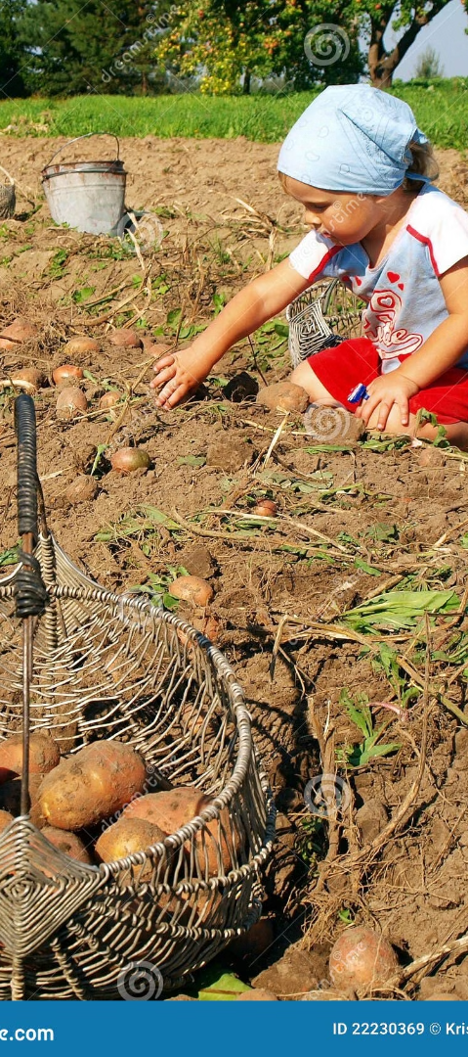
Potato Sourcing and Preparation
1
Potato Sourcing
Lay's sources potatoes from the best growing regions, working closely with local farmers to ensure a consistent supply of the freshest, most flavorful potatoes.
2
Careful Inspection
Each batch of potatoes is thoroughly inspected to meet Lay's high standards for size, shape, and quality before being processed.
3
Precise Cutting
The potatoes are expertly sliced into thin, uniform chips to ensure even cooking and a perfect crunch in every bite.

Slide 18
Frying and Seasoning Process
Perfect Frying
Signature Seasonings
Flavor Innovation
Lay's chips are fried to golden perfection, using a carefully controlled process that ensures each chip is crispy on the outside and fluffy on the inside.
A variety of delicious seasonings are applied to the chips, from classic salt to bold flavors, creating the iconic Lay's taste that has captivated snack lovers for generations.
Lay's is constantly innovating, introducing new and exciting flavors to keep up with changing consumer tastes and preferences.

Slide 19

Packaging and Distribution
Protective Packaging
Widespread Distribution
Sustainable Efforts
Lay's is committed to reducing its environmental impact, exploring eco-friendly packaging solutions and streamlining its distribution network to minimize its carbon footprint.
Lay's chips are packaged in sturdy, airtight bags to preserve their freshness and crunch, ensuring a delightful snacking experience every time.
Lay's potato chips can be found in grocery stores, convenience shops, and vending machines across the country, making them readily available to snack lovers everywhere.

Slide 20

Quality Assurance and Continuous Improvement
Customer Feedback
2
1
Rigorous Testing
Lay's employs a team of experts who conduct extensive testing at every stage of the production process to ensure the highest quality and safety standards are met.
Lay's values customer feedback and uses it to drive continuous improvement, constantly refining their products and processes to better meet the needs and preferences of their loyal snack enthusiasts.
3
Sustainability Initiatives
Lay's is committed to sustainability, exploring ways to reduce waste, conserve resources, and minimize the environmental impact of their operations, ensuring a brighter future for generations to come.

Slide 21
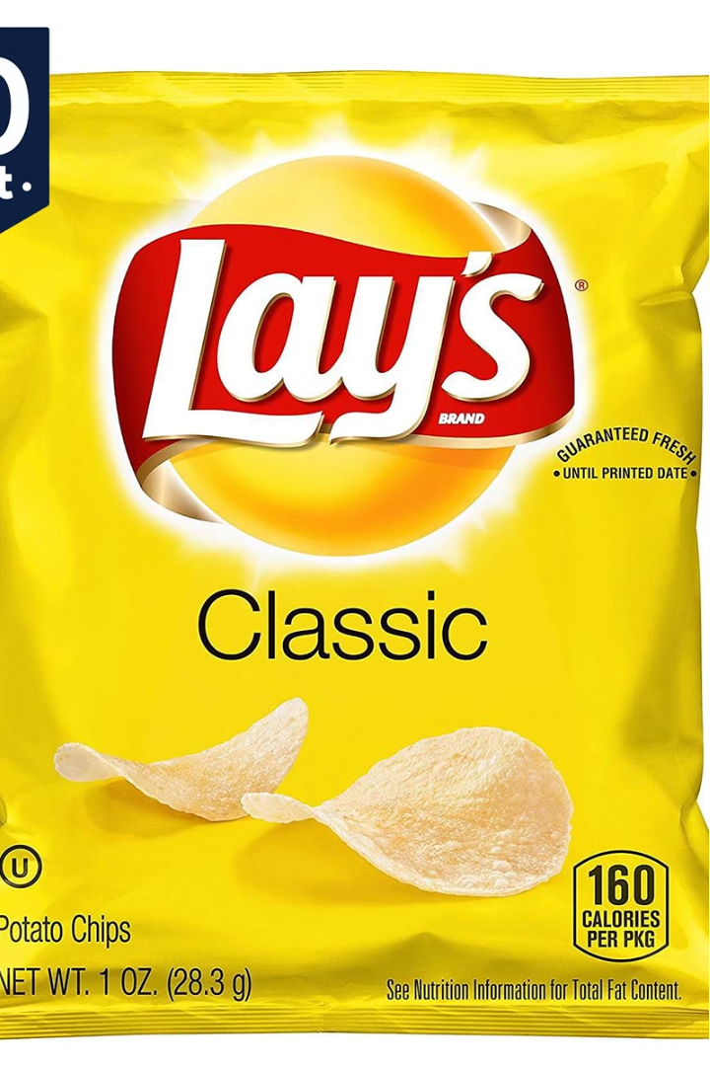
Administrative Development in Lays
Lays, the iconic snack brand, has a robust administrative infrastructure that supports its global operations. From streamlining supply chains to optimizing workforce management, Lays' administrative development ensures the company's agility and responsiveness to market demands.

Slide 22
Key Initiatives in Administrative Optimization
Streamlined Processes
Data-Driven Insights
Innovation and Product Development
Lays has implemented lean management principles to eliminate waste and redundancy, resulting in faster turnaround times and improved operational efficiency.
The company leverages advanced analytics to make informed decisions, optimize resource allocation, and drive continuous improvement across the organization.
Investing in research and development to create healthier snack options, innovative packaging solutions, and new product lines.

Slide 23

Streamlining Processes for Operational Efficiency
Process Mapping
Continuous Improvement
Lays fosters a culture of continuous improvement, empowering employees to identify and implement process optimizations.
Lays' teams carefully map out existing workflows to identify areas for improvement and streamlining.
1
2
3
Automation and Digitization
The company embraces automation and digital technologies to eliminate manual tasks and enhance productivity.

Slide 24
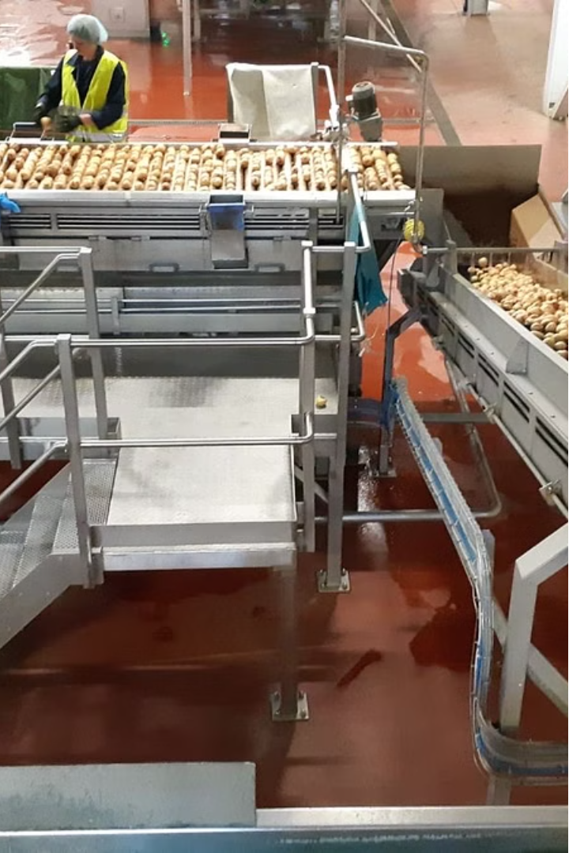
Service Development at Lays
Lays is known for its innovative approach to product development, constantly exploring new flavors and formulations to delight its customers. The service development team works closely with R&D to identify emerging trends and translate them into exciting new chip offerings.

Slide 25
Product Innovation
Culinary Inspiration
Consumer Insights
Agile Development
The Lays team draws inspiration from global cuisines, local flavors, and food trends to ideate unique chip varieties that tantalize the taste buds.
Extensive market research and customer feedback help guide the innovation process, ensuring Lays products align with evolving consumer preferences.
The service development process is highly iterative, allowing the team to quickly prototype, test, and refine new chip concepts.

Slide 26
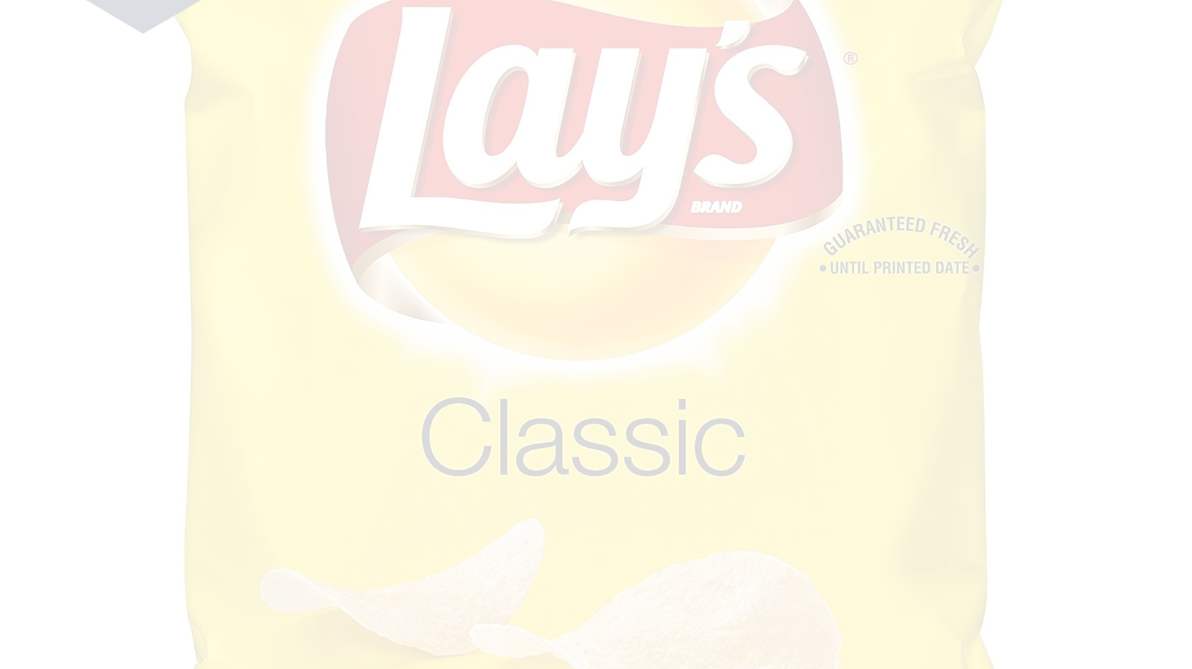



Operational Efficiency
Optimized Production
Supply Chain Synergies
Sustainability Initiatives
Lays has streamlined its manufacturing processes to enhance productivity and ensure consistent quality across its chip varieties.
The company leverages its global logistics network to efficiently source ingredients and distribute products, minimizing costs and environmental impact.
Lays is committed to reducing its carbon footprint and promoting sustainable practices throughout its operations.

Slide 27
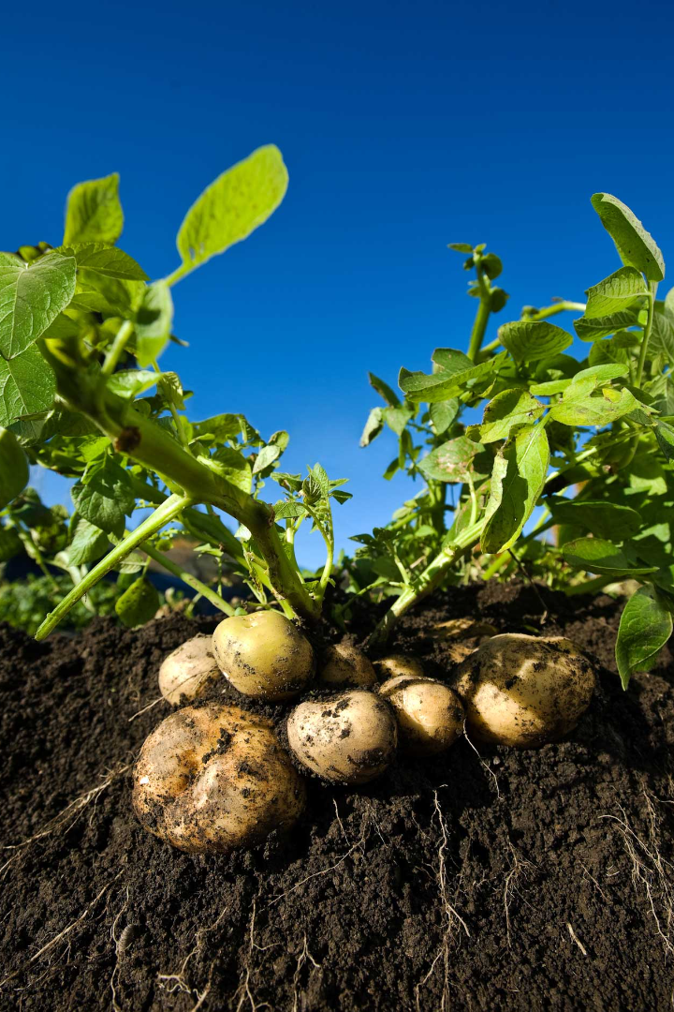
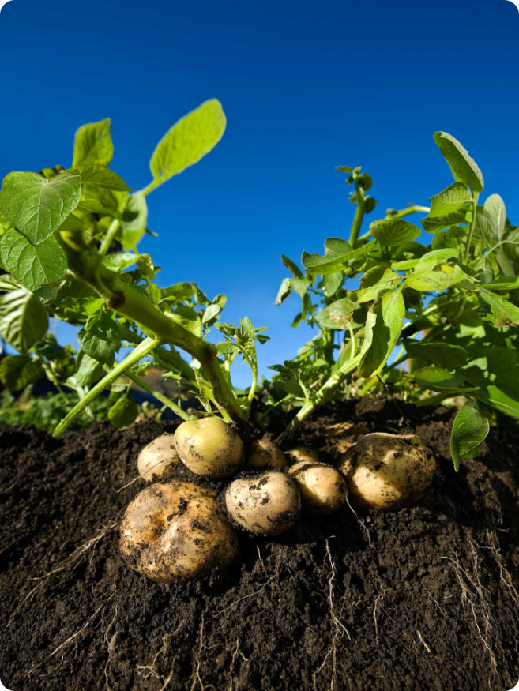
Sustainability Initiatives
Sustainable Sourcing
Lay's is committed to sourcing potatoes from sustainable farms that prioritize responsible agricultural practices. This includes reducing water use and minimizing environmental impact.
Packaging Reduction
The company is working to reduce its packaging footprint by using recycled materials and minimizing waste. This includes optimizing packaging sizes and exploring alternative packaging solutions.
Carbon Footprint Reduction
Lay's is focused on reducing its carbon footprint across its operations. This includes optimizing energy use in its factories and exploring renewable energy sources.

Slide 28


Quality Assurance and Control
Ingredient Testing
Rigorous testing of raw materials to ensure quality and safety
Production Process Monitoring
Monitoring all stages of the production process to maintain quality standards
Product Inspection
Thorough inspection of finished products to ensure compliance with quality standards
Consumer Feedback Monitoring
Gathering and analyzing consumer feedback to identify areas for improvement

Slide 29


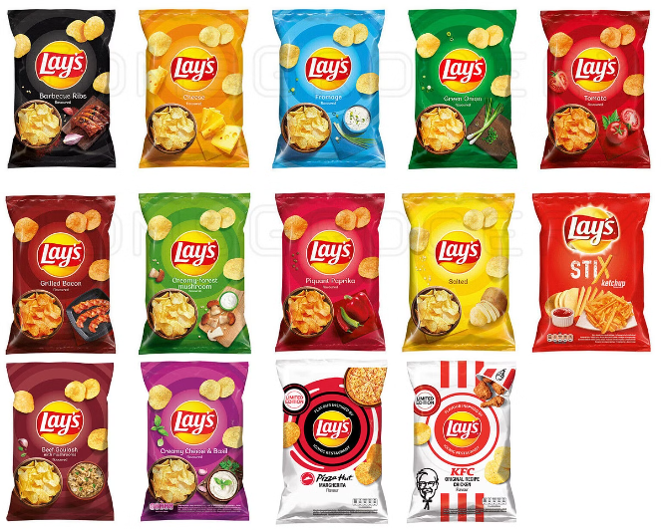



Future Initiatives and Expansion Plans
New Product Development
Lays continuously innovates and introduces new flavors and product varieties to meet evolving consumer preferences.
Global Expansion
Lays continues to expand its presence in new markets, bringing its chips to more consumers worldwide.
Sustainability Initiatives
Lays is committed to sustainable practices, reducing its environmental impact and supporting ethical sourcing.
Digital Marketing & Technology
Lays leverages digital marketing and technology to enhance its brand awareness, customer engagement, and sales.

